Slide 1
Traffic Data Analysis
AJ Fairweather

Slide 2
Introduction
AJ Fairweather
The objective is to demonstrate visually analysis of a dataset from the UK Department for Transport on the road network use by different types of vehicles from 1993-2018.
This was done by:
Data preparation
Numerical operations
Data visualisation with Bokeh
These actions were performed to find insights into trends found in traffic amongst road users on the UK road networks.

Slide 3
Summary of Accomplishments
AJ Fairweather
Situation: Given the UK Department for Transport dataset, complete a series of assignments.
Objective: Visualise insights and trends of the dataset.
Action: Ulitizing Bokeh, visualise and refine plots to create both functional and aesthetic graphs to demonstrate traffic properties
Results: Assignment was completed with 100% of tasks implemented correctly.
Aftermaths: Additional development in visualisation skills. If task was to be redone, additional research would be invested in determining more properties of plots increased functionality.

Slide 4
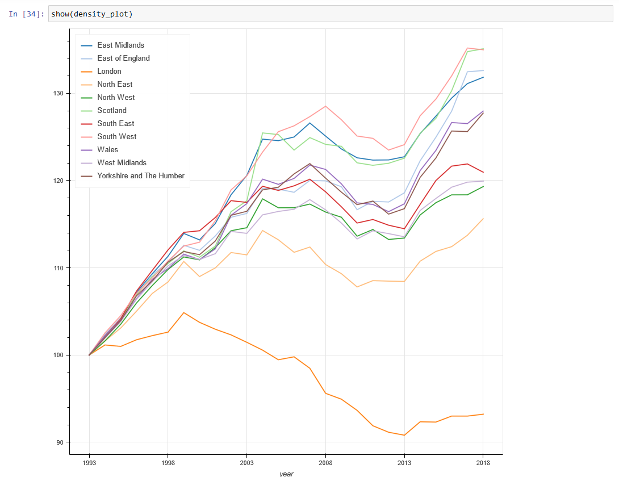
Traffic Analysis
AJ Fairweather
A series of assignments required a the following skills to be demonstrated:
Mathematical operations
Data manipulation
Index resetting
Pivot functions
Plot manipulation
The resulting graph can be seen adjacently

Slide 5
Traffic Anlaysis- Evidence
AJ Fairweather
A set of assignments set out to analyis road useage by vehicle type over time.
This used the datasets full time-span and provided valuble insights on how road use has changed.
Interestingly, from the data provided, all road usage was somewhat similar early in the dataset, but then as time progresses we can see an increase in cars, taxis and all hgvs, whilst pedal cycles was consistently the least used.
This changed just after 2008, after this point whilst car and taxis has remained steady to 2018, pedal cycles becomes the most used vehicle type, whilst HGV’s become the least.

Slide 6
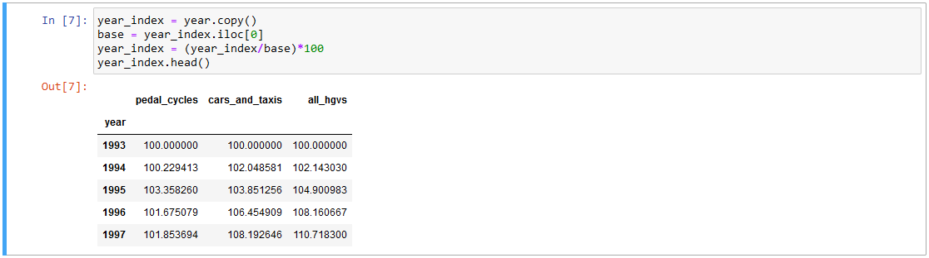
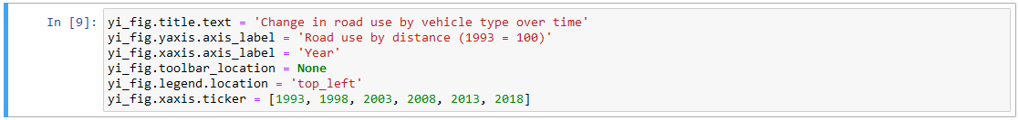
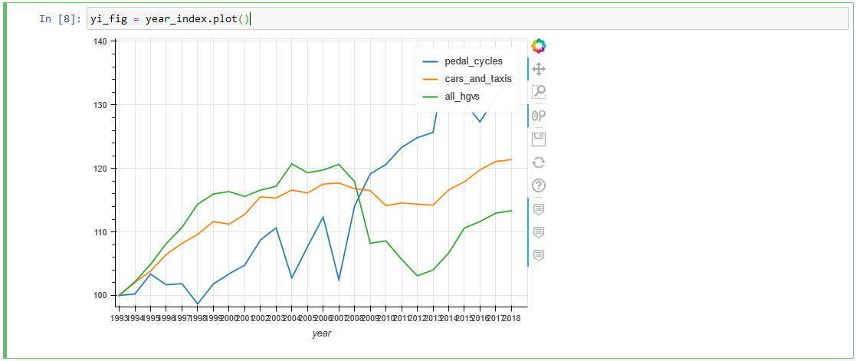
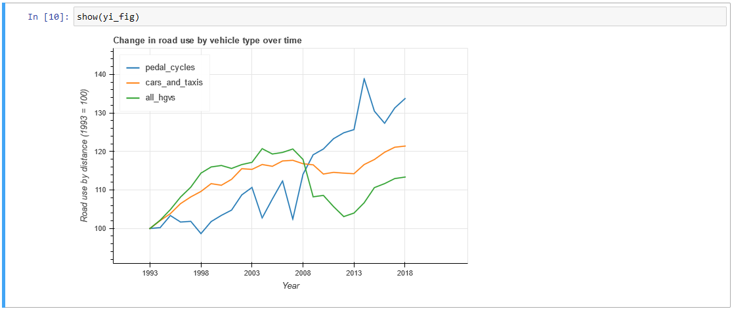
[Data Project Title]
Your Name
Explain the work you’ve complete here

Slide 7
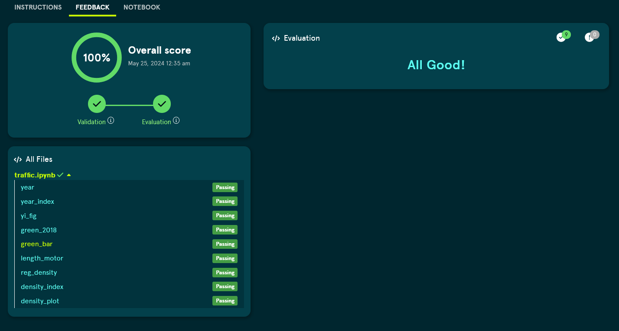
Traffic Analysis - Evidence
Your Name

